Slide 1
Knapsack problem(Genetic algorithm)

Slide 2
Knapsack
The knapsack problem involves a set of items, each with a weight and a value, and a knapsack with a maximum weight capacity.
The goal is to maximize the total value of items in the knapsack without exceeding its weight capacity.

Slide 3
Problem
Item 1: Value = 10, Weight = 5
Item 2: Value = 7, Weight = 3
Item 3: Value = 25, Weight = 12
Item 4: Value = 24, Weight = 10
Item 5: Value = 15, Weight = 8
Knapsack Capacity: 20

Slide 4
Step 1: Initialize Population
Let's start with a population of 6 individuals.
Each individual is represented by a binary string of length 5(because of 5 items), where each bit indicates whether an item is included (1) or excluded (0).
Individual 1: 11001
Individual 2: 10101
Individual 3: 01101
Individual 4: 10010
Individual 5: 11100
Individual 6: 01011

Slide 5
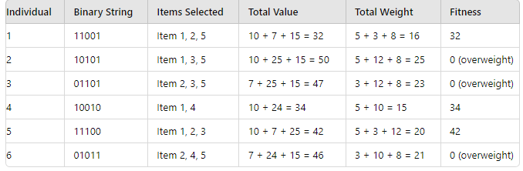
Step 2: Evaluate Fitness
Calculate the fitness of each individual. The fitness function will be the total value of the selected items, penalized if the total weight exceeds the knapsack capacity.

Slide 6
Step 3: Selection
Select parents based on fitness. We'll use roulette wheel selection for this purpose.
Individual 1: 32/108
Individual 2: 0/108
Individual 3: 0/108
Individual 4: 34/108
Individual 5: 42/108
Individual 6: 0/108

Slide 7
Step 3: Selection
Select parents based on fitness. We'll use roulette wheel selection for this purpose.
Selected Parents (proportional to fitness):
Parent 1: Individual 5 (42/108)
Parent 2: Individual 4 (34/108)
Parent 3: Individual 1 (32/108)
Parent 4: Individual 5 (42/108)

Slide 8
Step 4: Crossover
Perform crossover to generate offspring. We'll use single-point crossover.
Parent 1: 11100
Parent 2: 10010
Single-point crossover at position 3:
Offspring 1: 11110
Offspring 2: 10000

Slide 9
Parent 3: 11001
Parent 4: 11100
Single-point crossover at position 2:
Offspring 3: 11101
Offspring 4: 11000
Parent 1: 11100
Parent 3: 11001
Single-point crossover at position 4
Offspring 5: 11101
Offspring 6: 11000

Slide 10
Step 5: Mutation
Apply mutation with a small probability (e.g., 1%). For simplicity, let's assume no mutation occurs in this generation.

Slide 11
Step 6: Replacement
Replace the old population with the new population.
New Population:
Individual 1: 11110
Individual 2: 10000
Individual 3: 11101
Individual 4: 11000
Individual 5: 11101
Individual 6: 11000

Slide 12
Step 7: Termination
Evaluate the fitness of the new population and repeat steps 3-6 until the termination condition is met (e.g., a fixed number of generations or convergence).

